Slide 1
Digital Portfolio
STUDENT NAME: Rajesh Swarna Lakshmi
REGISTER NO AND NMID: 2428M0050/9135BA293B9266E9910402D6734FDE0F
DEPARTMENT: Bsc DataScience
COLLEGE/ UNIVERSITY: Kumaraguru College of Liberal Arts and Science/ Bharathiyar University

Slide 2
PROJECT TITLE
Interactive digital portfolio using FWD

Slide 3


AGENDA
Problem Statement
Project Overview
End Users
Tools and Technologies
Portfolio design and Layout
Features and Functionality
Results and Screenshots
Conclusion
Github Link
3/21/2024 Annual Review

Slide 4

PROBLEM STATEMENT
Traditional paper-based portfolios fail to showcase student achievements dynamically and are difficult to update or share effectively. There is a need for a digital solution that allows creative, interactive, and easily updatable portfolios using modern web technologies like FWD.

Slide 5

PROJECT OVERVIEW
This project introduces a web-based interactive digital portfolio application built with FWD. It enables students to present academic projects, skills, and extracurricular achievements through engaging layouts, multimedia integration, and responsive design, making the presentation process streamlined and impactful.

Slide 6

WHO ARE THE END USERS?
1)Students seeking to showcase their skills and achievements
2)Job recruiters and HR professionals
3)College faculty and placement officers
4)Admission committees for higher studies

Slide 7

TOOLS AND TECHNIQUES
HTML
CSS
JavaScript
Code Editor (Codepen)

Slide 8
PORTFOLIO DESIGN AND LAYOUT
The portfolio's design is a modern, dark-themed layout that uses a sleek and professional aesthetic. It employs a clean color scheme with a dark background, light text, and vibrant blue accents for headings, creating a strong visual hierarchy. The website is structured as a single-page site with a sticky navigation bar that ensures easy access to all sections. Content is organized into distinct blocks, such as the three-column grid for project cards, making the information easy to digest. Overall, the design prioritizes user experience with a responsive layout and an uncluttered interface, ensuring the site looks and functions well on both desktop and mobile devices.
8

Slide 9
FEATURES AND FUNCTIONALITY
Homepage:
The homepage serves as a landing page for visitors and introduces the portfolio's owner, Rajesh Swarna Lakshmi. It includes a prominent heading with a personal introduction and a button labeled "View My Work" to guide visitors to the projects section. The navigation bar at the top remains visible and contains links to the Home, About, Projects, and Contact sections, ensuring easy navigation throughout the site.
About Me Section:
This section provides a summary of the portfolio owner's skills, experience, and professional goals. It highlights their proficiency in tools like Excel, SQL, and Python for data exploration and visualization. The content mentions experience in data cleaning and transformation, as well as working on projects related to forensic accounting AI: detecting financial statement manipulation and The role of AI and IOT in waste management . The section also states a desire for an impactful internship opportunity.

Slide 10
Projects Section:
The projects section showcases two distinct projects and the certifications completed, each with a brief description and a list of key tools used. This demonstrates practical application of the owner's skills.
Forensic accounting AI- detects financial statement manipulation: using machine learning, NLP, and data analytics tools like ACL and IBM Watson.
AI and IoT in waste management: use sensors and AI analytics for real-time monitoring, route optimization, and predictive maintenance with platforms like Azure IoT and Google Cloud
Certifications Completed
Completed a certification course on Data Analytics and Python through Coursera. The course covered key concepts of data analytics, including data cleaning, transformation, visualization, and statistical analysis using Python
Contact Form:
The website includes a "Contact Me" section with a simple form to allow visitors to get in touch. The form has three input fields for "Your Name", "Your Email", and "Your Message", along with a "Send" button. The provided JavaScript code snippet suggests there's a basic client-side validation for the form.

Slide 11

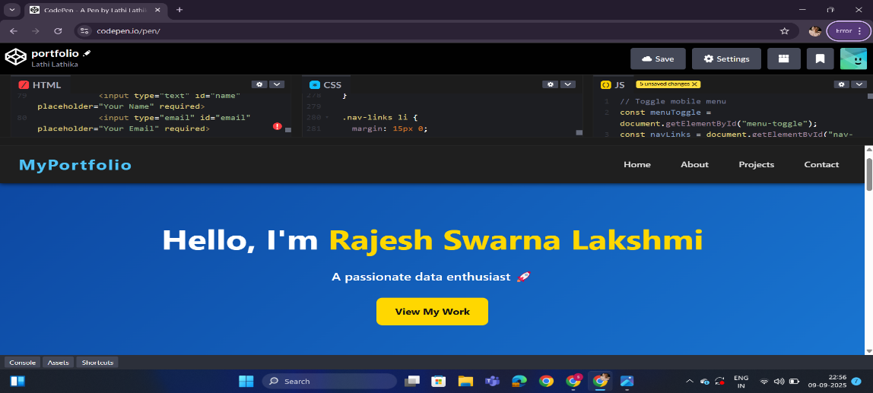
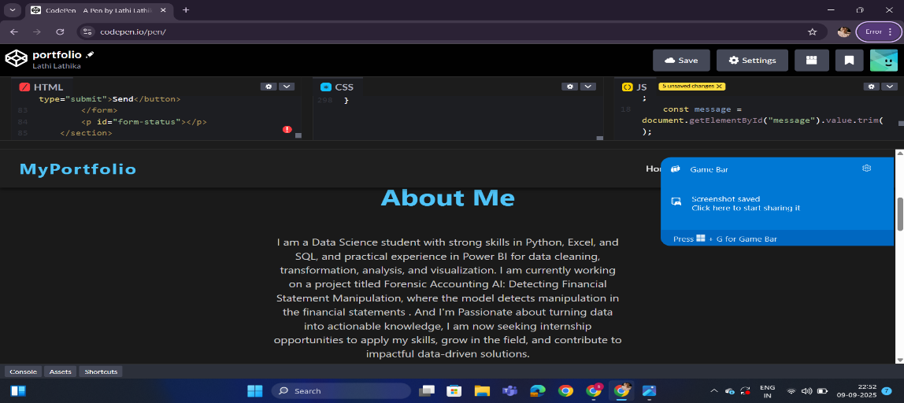

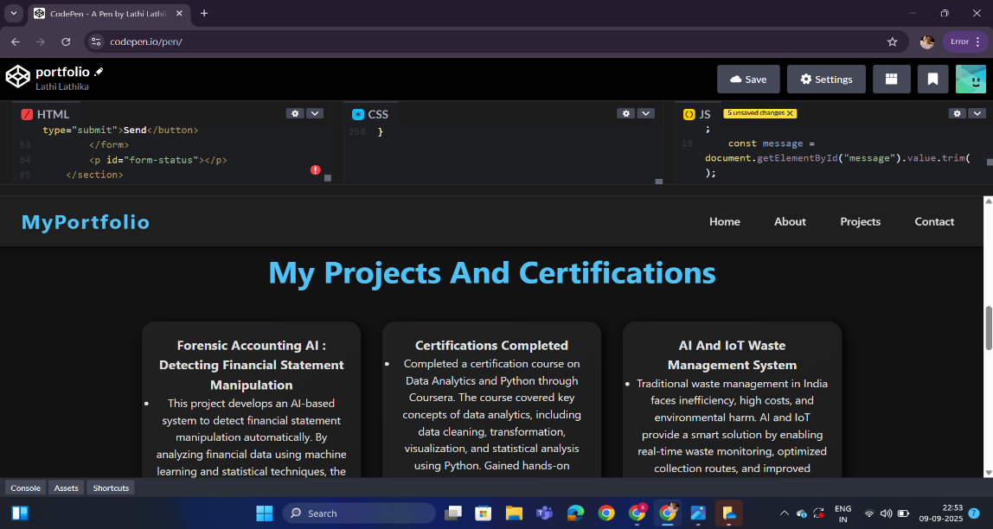
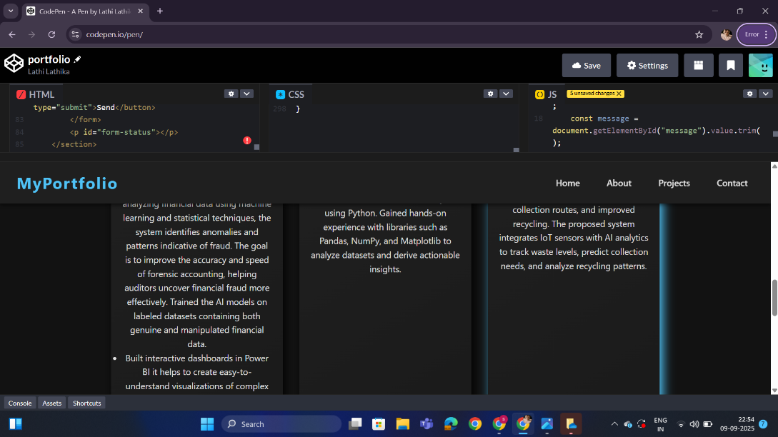
RESULTS AND SCREENSHOTS
3/21/2024 Annual Review
11

Slide 12
CONCLUSION
The Interactive Digital Portfolio Using FWD successfully addresses the limitations of traditional, static portfolios by offering an adaptable, visually appealing, and interactive solution for students and professionals. By utilizing modern Frontend Web Development (FWD) frameworks, the project empowers users to seamlessly update, customize, and enhance the presentation of their academic and extracurricular achievements.
This digital portfolio system not only streamlines the portfolio creation process but also ensures a responsive design that works efficiently across devices. The ability to add multimedia content, live previews, and personalized sections elevates the user’s online presence and leaves a strong impression on recruiters, faculty, and other stakeholders.
Moreover, the integration of Github, resume downloads, and user-friendly customization provides practical tools for real-world employability and personal branding. The project sets a foundation for further enhancements, such as integrating analytics to track portfolio visits or enabling interactive messaging with recruiters.
Overall, the project demonstrates how FWD-based digital portfolios are an essential upgrade for modern career-building, fostering both creativity and professionalism in self-presentation.
12

